Slide 1
G2M Cab Investment Case Study
Data glacier VIRTUAL INTERNSHIP
LISUM25-CHRISTEENA JOHN

Slide 2
BACKGROUND STUDY
INTRODUCTION-XYZ is a private company in the United States. Due to the spectacular rise in the Cab Industry in recent years and the presence of numerous significant players in the market, it is planning to invest in the Cab Industry, and as part of their Go-to-Market (G2M) strategy, they want to understand the market before making a final choice.

Slide 3
AIM &OBJECTIVE
AIM-To Provide actionable insights to assist XYZ firm in picking the best company for investment
To attain the aim different objectives have selected.
1.Loading the libraries
2.Dataset Understanding
3.Data Preprocessing
4.Exploratory Data Analysis

Slide 4
DATA EXPLORATION
24 Features (9 Derived Features Included)
Data was collected from 2016-01-31 to 2018-12-31.
355,032 total data points
4 Datasets including:
Cab_Data.csv - file includes details of transaction for 2 cab companies
Customer_ID.csv - mapping table that contains a unique identifier which links the customer’s demographic details
Transaction_ID.csv - a mapping table that contains transaction to customer mapping and payment mode
City.csv -file contains list of US cities, their population and number of cab users

Slide 5
METHODOLOGY
First the libraries are loaded to the google Collab
Then the 4 datasets are loaded and understanding of each dataset
Data Preprocessing is the third step. The steps include:
MASTERDATA CREATION
Data quality assessment
Data Cleaning
Checking for Missing Values
Identifying single-valued columns
Checking duplicates
Finding Outliers
Data transformation

Slide 6
METHODOLOGY
After the data preprocessing Explanatory Data Analysis is done .The Exploratory Data Analysis Include:
Features Analysis
Kilometers Travelled Distribution
Price Distribution
Cost of Trip Distribution
Age Distribution
COST per KM
Customer Payment Mode preference
Gender Preference for Cab Booking
Time series
Numerical features
Client Analysis
Profit Analysis

Slide 7
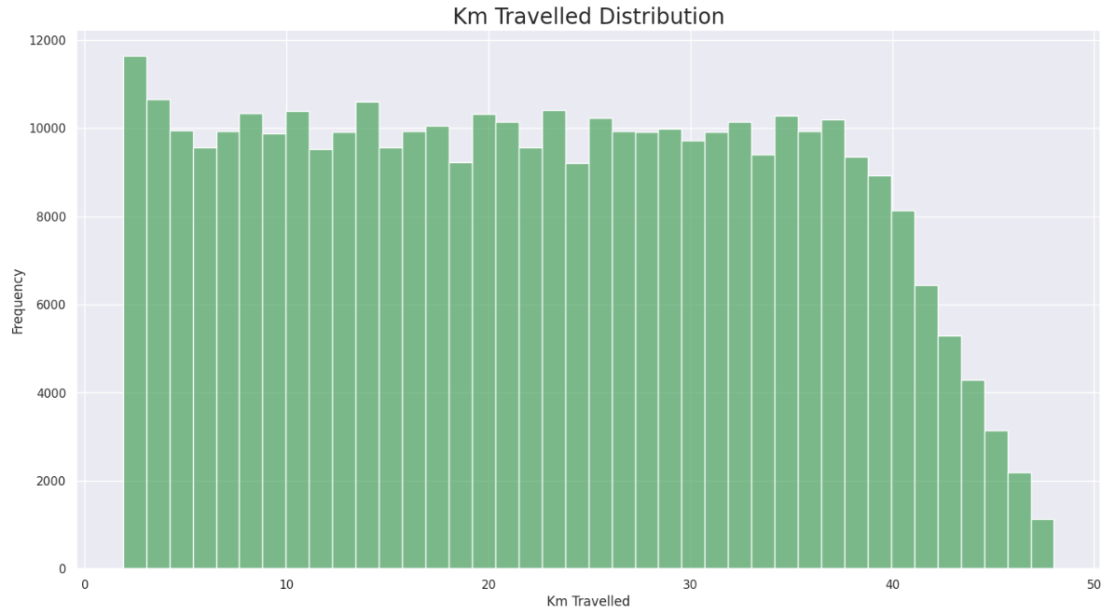

RESULTS

Slide 8
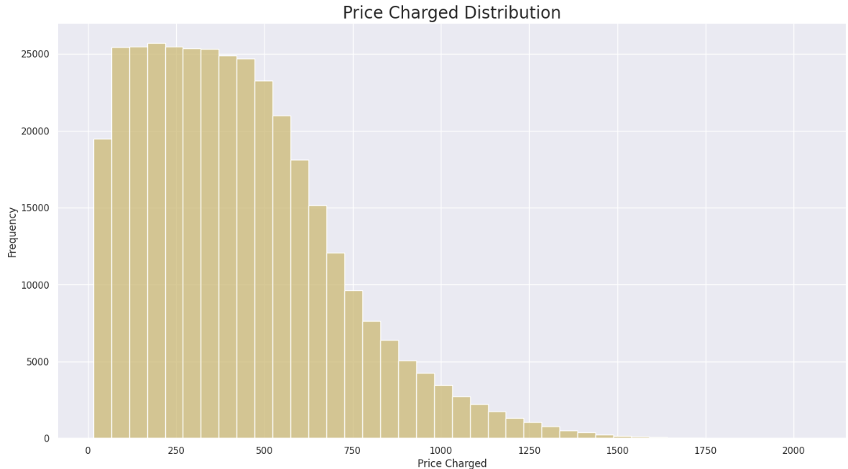
RESULTS

Slide 9
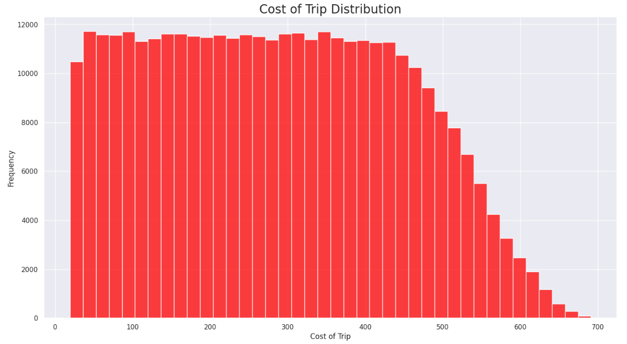

RESULTS

Slide 10
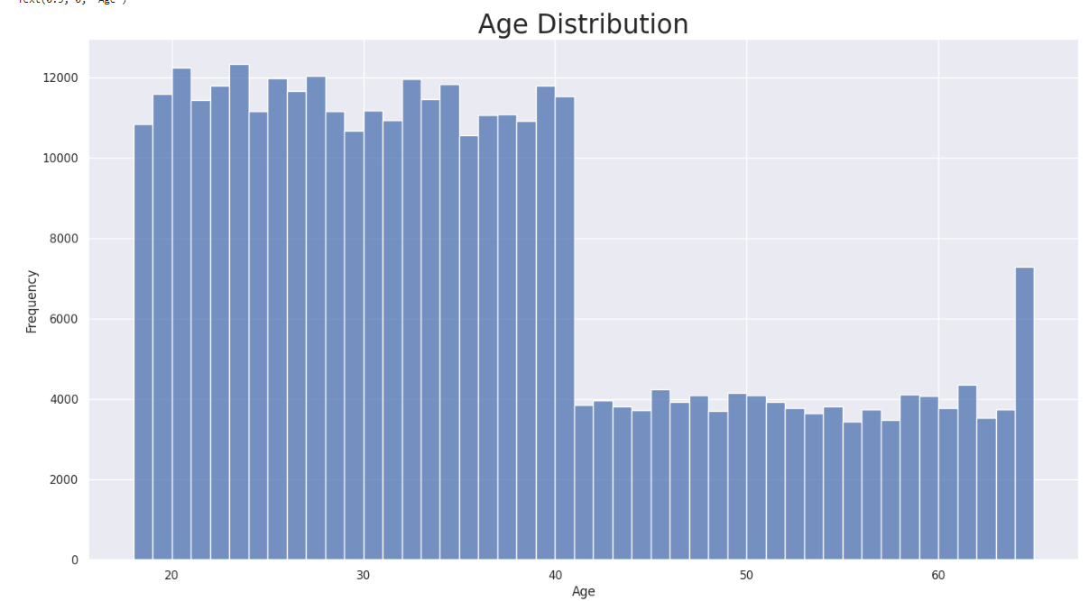
RESULTS

Slide 11
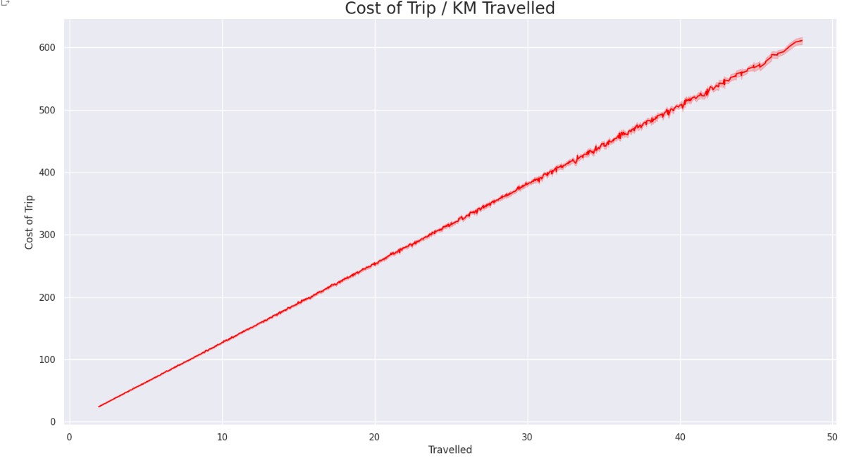

RESULTS

Slide 12
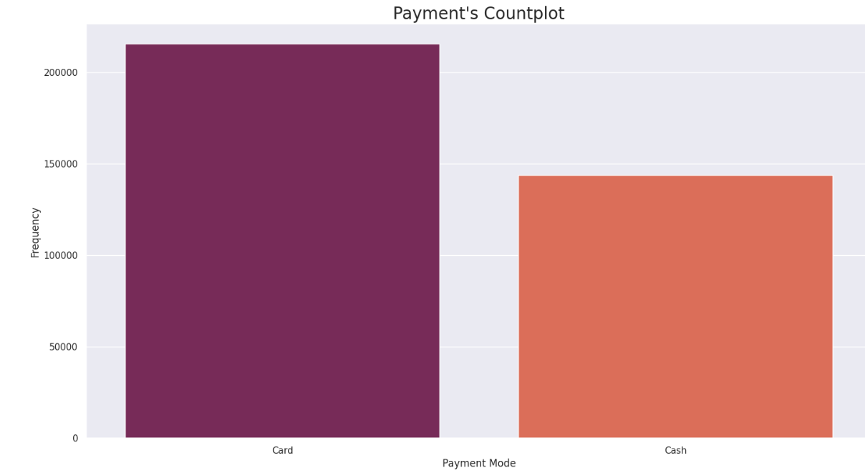

RESULTS

Slide 13
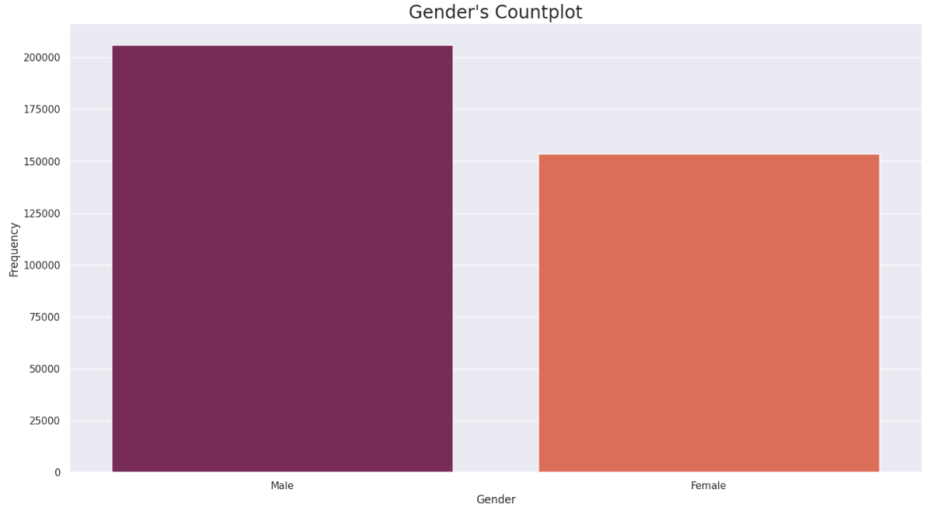

RESULTS

Slide 14
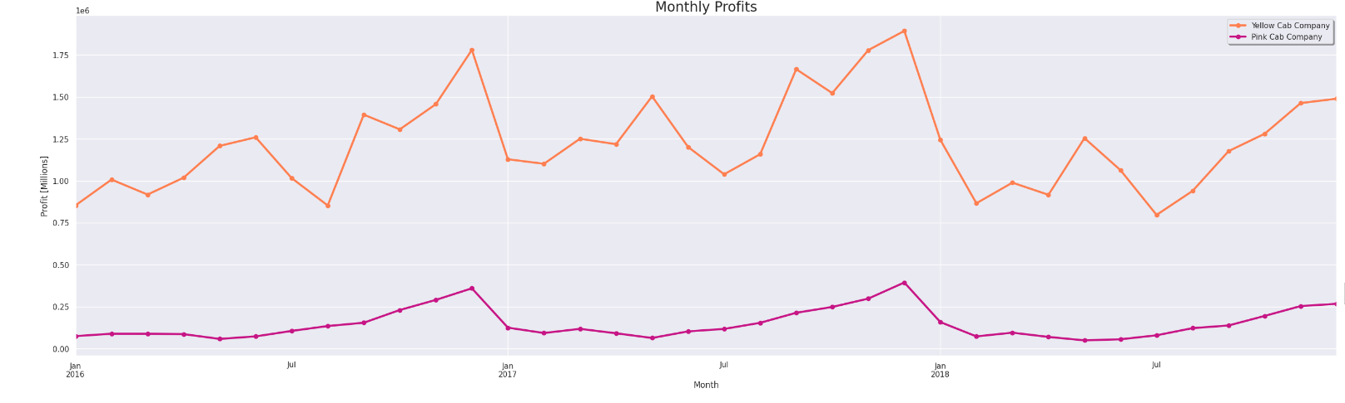
RESULTS

Slide 15
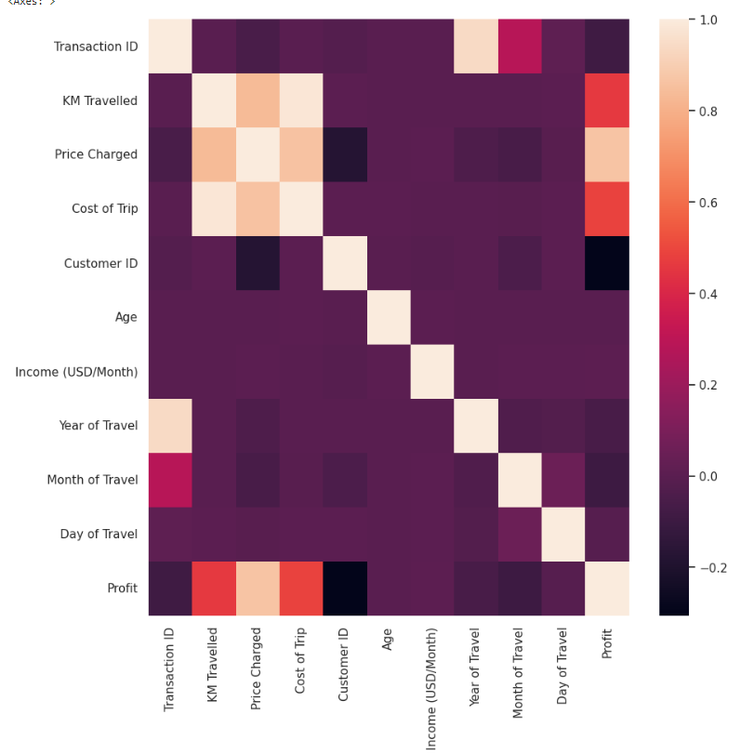
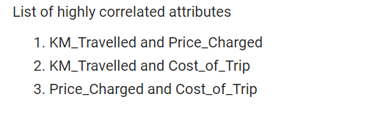
RESULTS

Slide 16
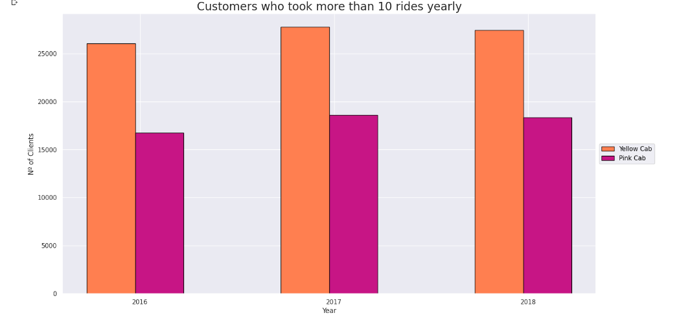
RESULTS

Slide 17
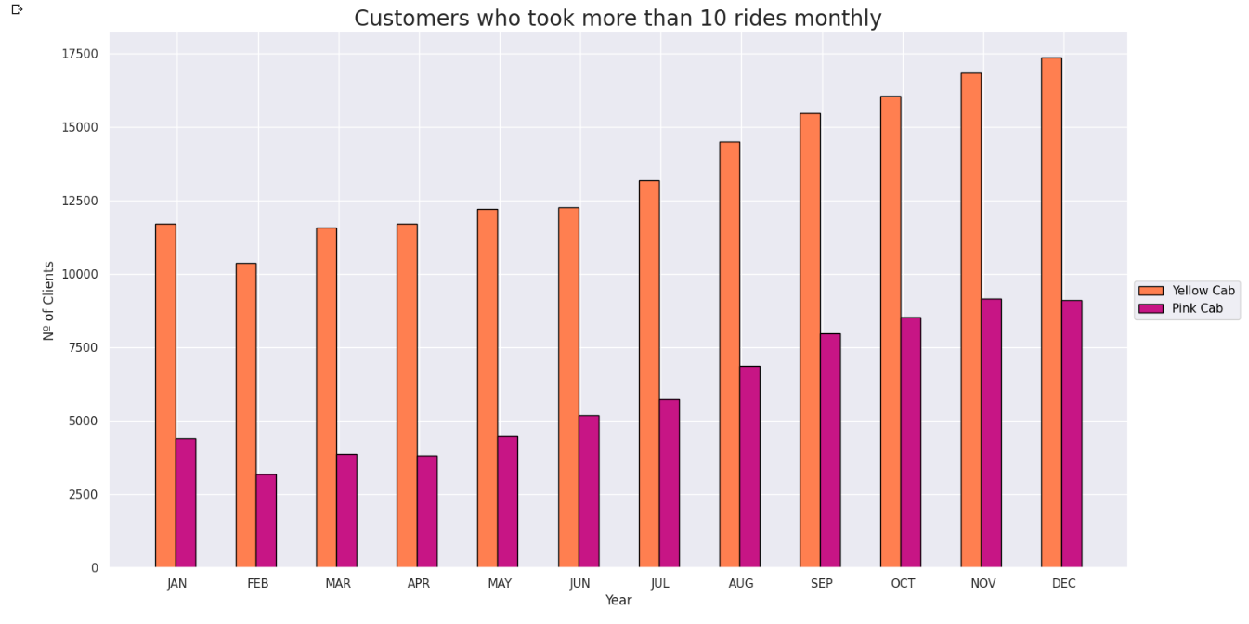

RESULTS

Slide 18
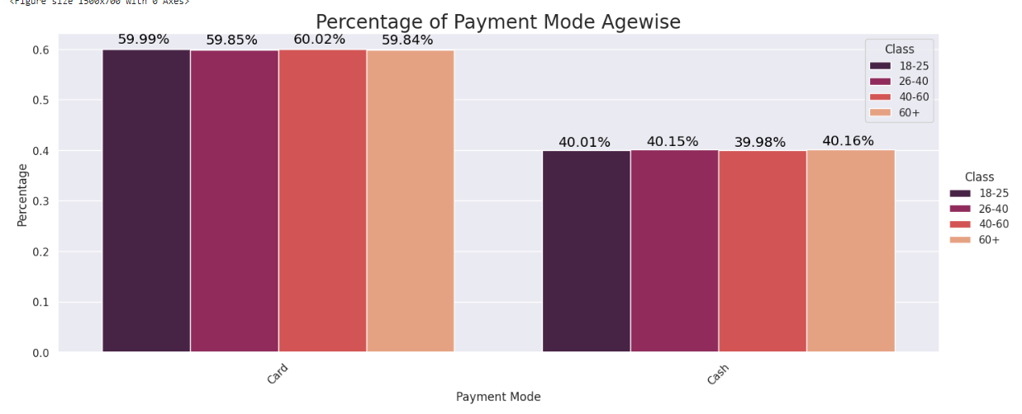
RESULTS

Slide 19
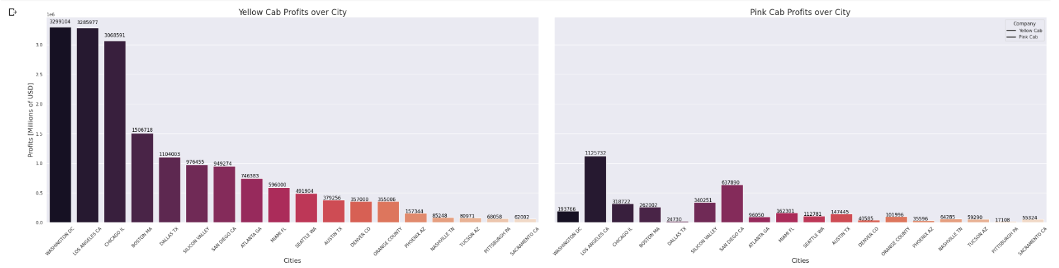

Slide 20
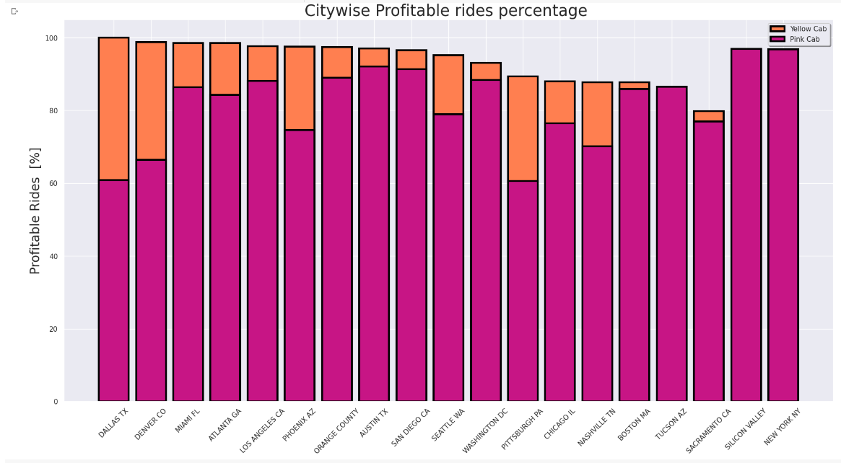
RESULTS

Slide 21
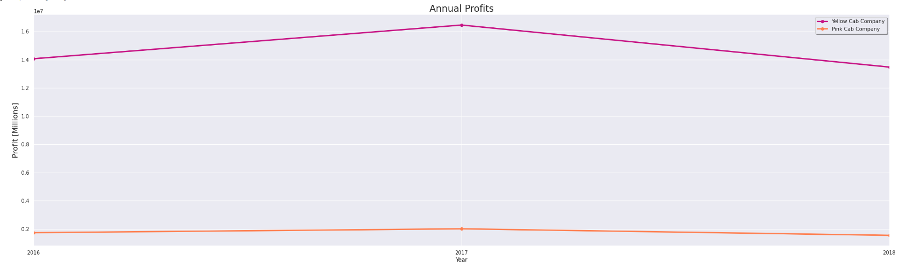
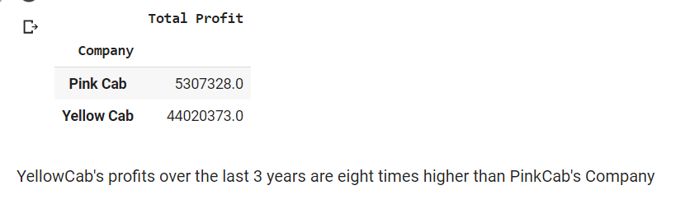
RESULTS

Slide 22
CONCLUSIONS
Yellow Cab is used more than Pink Cab. 76.4% of the rides are by Yellow Cab
November and December (10 and 12) have the most rides. Jan and Feb being the least
2018 has the highest cab rides but the 'Year of Travel" column approximately has fairly distributed data
NEW YORK NY has the highest number of rides vs PITTSBURGH PA with lowest
After 40KM there is gradual linear decrease in number of rides
Both the companies have same average KM travelled
On an average Pink cab contributes to 23% in total cab count for all three years
Mean Profit for Pink Cab on an Average for the three years is around 17-18
Mean Profit for Yellow Cab on an Average for the three years is around 28-31
Highest Profit Percentage of Pink Cab was for the months- March and December, lowest for the months- June and July
Highest Profit Percentage of Yellow Cab was for the months- May, Feb Jan and June, lowest for the months- August and July

Slide 23
THANK YOU

